Slide 1
BICOE Multi-Tenant Hadoop
9/30/2016

Slide 2
Overview
Multi-tenant is holding more than one database or environment in a single system.
In this case we are temporarily holding development and QA in the same cluster as Production. We will separate development and QA out of this cluster to a new, non-production cluster. Development and QA will remain on a combined cluster.
This presentation is to discuss how we cleanly and safely manage separate SDLC environments in a single cluster, while adhering to Rockwell Automation controls.
Perimeter & Data Security
Encryption At Rest
Encryption At Transit
Firewall

Slide 3
How do we keep Dev/QA/Prod Separate?
Focus on Quality
Goals of Quality Assurance efforts
Get to a common language
Think long term – system wide not project by project
Standards:
Code directories in Linux
Folders within HDFS
Structures
Naming
Coding
Environment Variables
Perimeter & Data Security
Encryption At Rest
Encryption At Transit
Firewall

Slide 4
Quality Assurance Goals
Key objectives of Quality Assurance are to consistently deliver high quality solutions that meet the business needs in a manner that is:
Sustainable
Supportable
Repeatable
Measurable
Documented
Operationally Agile
Secure
Auditable
Perimeter & Data Security
Encryption At Rest
Encryption At Transit
Firewall

Slide 5
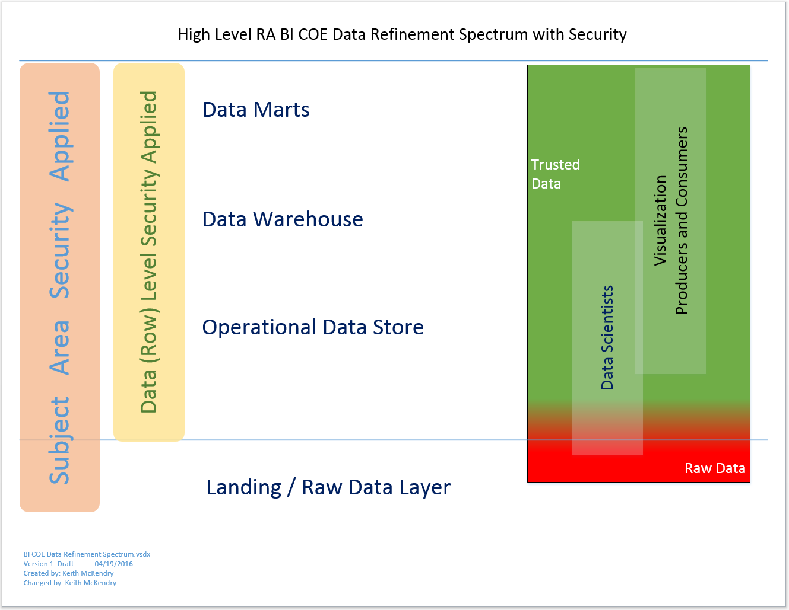
Data Refinement Spectrum
Perimeter & Data Security
Encryption At Rest
Encryption At Transit
Firewall

Slide 6
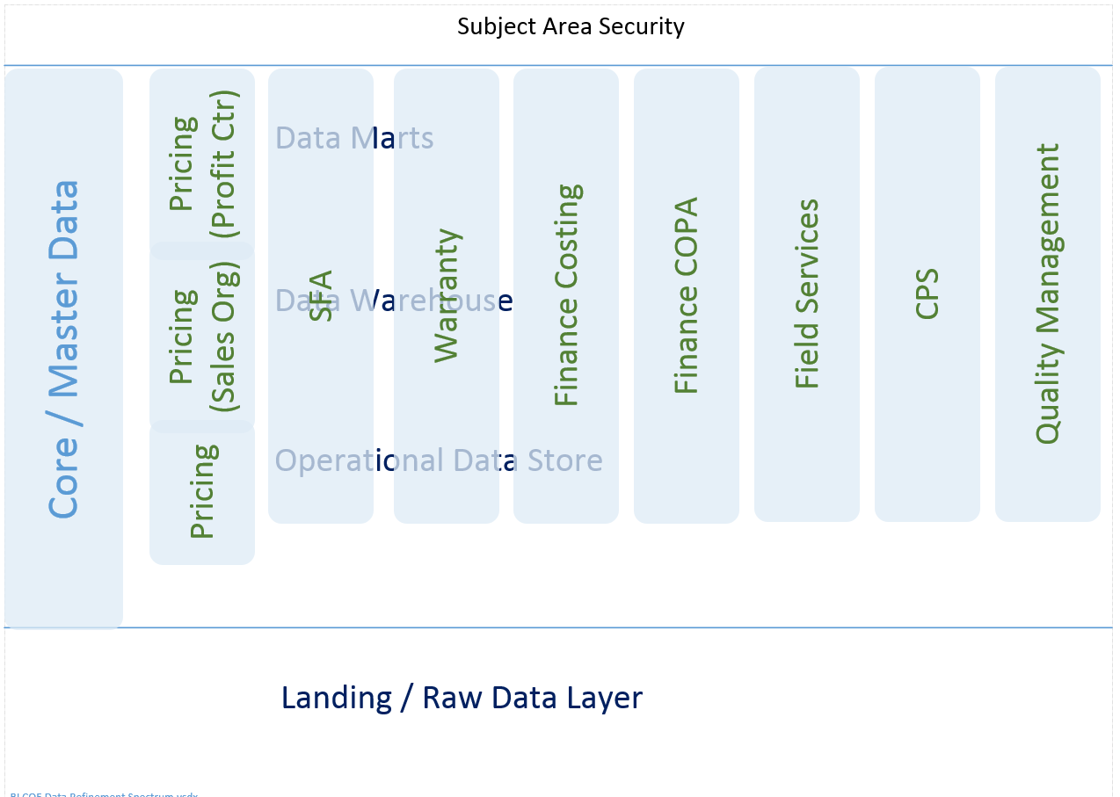
Subject Area Security
Perimeter & Data Security
Encryption At Rest
Encryption At Transit
Firewall

Slide 7
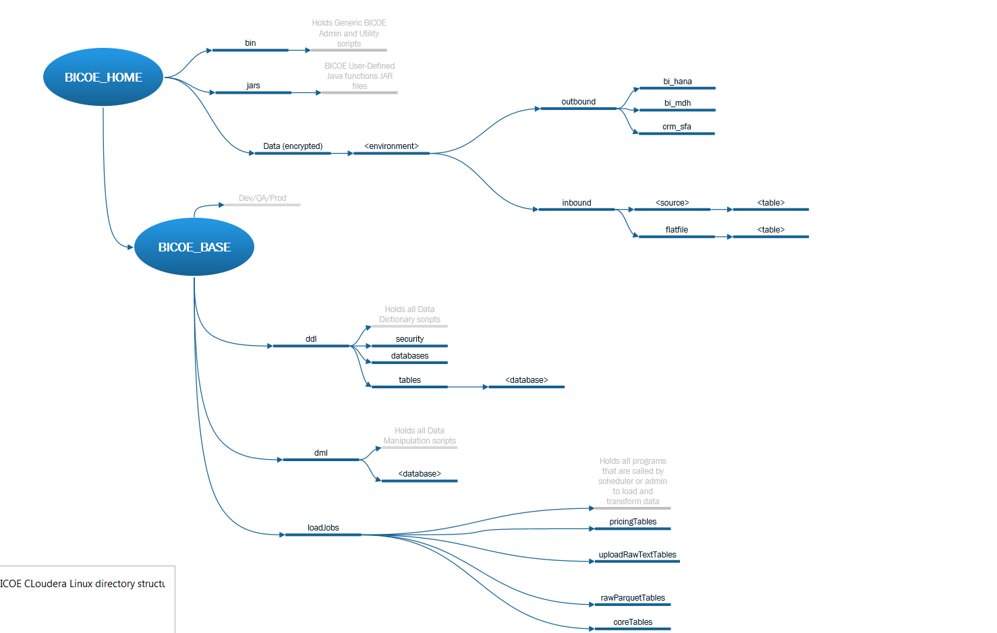
Directory Structure
Perimeter & Data Security
Encryption At Rest
Encryption At Transit
Firewall

Slide 8
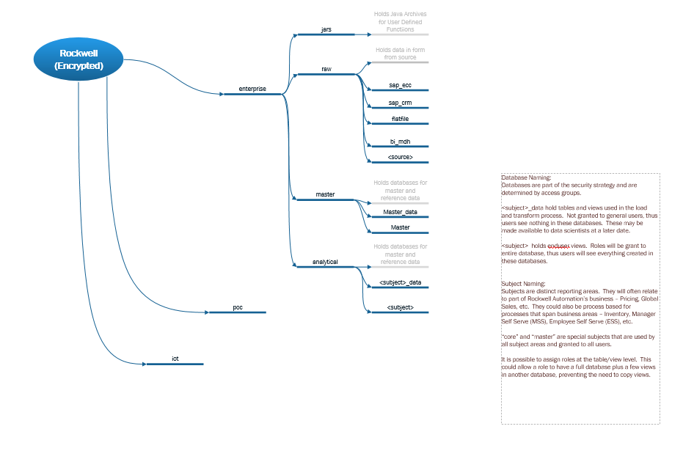
HDFS Folder Structure
Perimeter & Data Security
Encryption At Rest
Encryption At Transit
Firewall

Slide 9
How do I know I’m in Dev vs QA vs Prod
This is rather easy. Look at database names and directory names
Database names will have “d_”, “q_”, or “p_” for dev, qa, and production, respectively.
Directories will have “dev”, “qa”, or “prod” in the path.
If in Linux, your environment variables show the environment:
echo $BICOE_ENV -- shows dev, qa, or prod
echo $BICOE_BASE -- shows path to base directory (includes dev, qa, or prod)
Echo $HIVE_ENV -- shows “d_”, “q_”, or “p_”
Note that the environment variable are used in scripts to control processing.
Perimeter & Data Security
Encryption At Rest
Encryption At Transit
Firewall

Slide 10
Examples: Directories and Folders
Development:
<BICOE_BASE> ➔ /apps/bicoe/dev
Table creates for SAP_ECC ➔ /apps/bicoe/dev/ddl/tables/sap_ecc
Table or view creates for CORE ➔ /apps/bicoe/dev/ddl/tables/core
Load scripts for SAP_CRM ➔ /apps/bicoe/dev/dml/sap_crm
Load scripts for CORE_DATA ➔ /apps/bicoe/dev/dml/core_data
QA:
<BICOE_BASE> ➔ /apps/bicoe/qa
Table creates for SAP_ECC ➔ /apps/bicoe/qa/ddl/tables/sap_ecc
Table or view creates for CORE ➔ /apps/bicoe/qa/ddl/tables/core
Load scripts for SAP_CRM ➔ /apps/bicoe/qa/dml/sap_crm
Load scripts for CORE_DATA ➔ /apps/bicoe/qa/dml/core_data
Perimeter & Data Security
Encryption At Rest
Encryption At Transit
Firewall

Slide 11
Examples: Directories and Folders
Rockwell Enterprise data (<RA_ENTERPRISE>)
/user/hive/warehouse/rockwell/enterprise/
Development: (folder path after ‘rockwell’ above)
SAP_ECC ➔ raw/d_sap_ecc.db
MASTER_DATA ➔ master/d_master_data.db
CORE_DATA ➔ analytical/d_core_data.db
QA: (folder path after ‘rockwell’ above)
SAP_ECC ➔ raw/q_sap_ecc.db
MASTER_DATA ➔ master/q_master_data.db
CORE_DATA ➔ analytical/q_core_data.db
Perimeter & Data Security
Encryption At Rest
Encryption At Transit
Firewall

Slide 12
Linux Shell Examples (Environment Variables)
export HIVE_ENV=d_
export BICOE_ENV=dev
export BICOE_HOME=/apps/bicoe
export BICOE_BASE=${BICOE_HOME}/${BICOE_ENV}
export HIVE_HOST="azrudb7001.ra.rockwell.com"
export HIVE_PORT=10000
export HIVE_URL="jdbc:hive2://${HIVE_HOST}:${HIVE_PORT}/default;principal=hive/_HOST@ra-int.com;ssl=true"
export HIVE_CONF="--hiveconf hive.exec.stagingdir=/user/hive/warehouse/rockwell/.hive-staging"
export BICOE_SCRIPT=${BICOE_BASE}/loadJobs
export BICOE_LOAD=${BICOE_HOME}/data/${BICOE_ENV}/inbound
export RA_ENTERPRISE=/user/hive/warehouse/rockwell/enterprise
Perimeter & Data Security
Encryption At Rest
Encryption At Transit
Firewall

Slide 13
Linux Shell Examples (call Hive)
#!/bin/bash
if [ $# -eq 0 ]
then
echo "Fail: Execution failed due to missing beeline config file path."
exit 1
fi
BEELINE_CONFIG=$1
. "${BEELINE_CONFIG}"
. "./config.cfg"
# export HADOOP_CLIENT_OPTS="-Djline.terminal=jline.UnsupportedTerminal"
for file in `ls ${HIVESCR_ECC_TEXT}\/S*.ctl`
do
echo $file
beeline -u ${HIVE_URL} ${HIVE_USER} ${HIVE_CONF} -f $file --hivevar env=${HIVE_ENV}
done
Perimeter & Data Security
Encryption At Rest
Encryption At Transit
Firewall

Slide 14
Hadoop DDL Examples
Create EXTERNAL TABLE If Not Exists ${env}SAP_ECC.SETNODE
(MANDT STRING
,SETCLASS STRING
,SUBCLASS STRING
,SETNAME STRING
,LINEID DECIMAL(10,0)
,SUBSETCLS STRING
,SUBSETSCLS STRING
,SUBSETNAME STRING
,SEQNR INT
)
ROW FORMAT DELIMITED
FIELDS TERMINATED BY '28'
STORED AS textfile
LOCATION '/user/hive/warehouse/rockwell/enterprise/raw/${env}sap_ecc.db/setnode/'
TBLPROPERTIES("SKIP.HEADER.LINE.COUNT"="0");
Perimeter & Data Security
Encryption At Rest
Encryption At Transit
Firewall

Slide 15
Hadoop DDL Examples
Create EXTERNAL TABLE If Not Exists ${env}sap_ecc.tvta_parq LIKE ${env}sap_ecc.tvta
ROW FORMAT DELIMITED
FIELDS TERMINATED BY '28'
STORED AS parquet
LOCATION '/user/hive/warehouse/rockwell/enterprise/raw/${env}sap_ecc.db/tvta_parq/'
TBLPROPERTIES("SKIP.HEADER.LINE.COUNT"="0");
========================================================================
DROP VIEW IF EXISTS ${env}pricing.toe_V1;
CREATE VIEW IF NOT EXISTS ${env}pricing.toe_V1 AS
SELECT * FROM ${env}pricing_data.toe;
Perimeter & Data Security
Encryption At Rest
Encryption At Transit
Firewall

Slide 16
Hadoop DML Example
CREATE TABLE IF NOT EXISTS ${env}SAP_ECC.2lis_13_vdkon_tmp
ROW FORMAT DELIMITED
FIELDS TERMINATED BY '28'
STORED AS parquet
LOCATION '/user/hive/warehouse/rockwell/enterprise/raw/${env}sap_ecc.db/2lis_13_vdkon_tmp/'
TBLPROPERTIES("SKIP.HEADER.LINE.COUNT"="0")
AS
SELECT * FROM ${env}SAP_ECC.2lis_13_vdkon;
LOAD DATA INPATH '/user/hive/warehouse/rockwell/enterprise/raw/${env}sap_ecc.db/2lis_13_vdkon_tmp/' OVERWRITE INTO TABLE ${env}SAP_ECC.2lis_13_vdkon_parq;
DROP TABLE IF EXISTS ${env}SAP_ECC.2lis_13_vdkon_tmp PURGE;
-- TRUNCATE TABLE ${env}SAP_ECC.2lis_13_vdkon;
Perimeter & Data Security
Encryption At Rest
Encryption At Transit
Firewall

Slide 17
Hadoop DML Example Revised
beeline -u ${HIVE_URL} ${HIVE_USER} ${HIVE_CONF} --hivevar env=${HIVE_ENV} -f ${script}
Sample script
CREATE TABLE IF NOT EXISTS ${env}SAP_ECC.2lis_13_vdkon_<yyyymmdd>
ROW FORMAT DELIMITED
FIELDS TERMINATED BY '28'
STORED AS parquet
LOCATION '/user/hive/warehouse/rockwell/enterprise/raw/${env}sap_ecc.db/2lis_13_vdkon_<yyyymmdd>/'
TBLPROPERTIES("SKIP.HEADER.LINE.COUNT"="0")
AS
SELECT * FROM ${env}SAP_ECC.2lis_13_vdkon;
LOAD DATA INPATH '/user/hive/warehouse/rockwell/enterprise/raw/${env}sap_ecc.db/2lis_13_vdkon_tmp/' OVERWRITE INTO TABLE ${env}SAP_ECC.2lis_13_vdkon_parq;
DROP TABLE IF EXISTS ${env}SAP_ECC.2lis_13_vdkon_tmp PURGE;
-- TRUNCATE TABLE ${env}SAP_ECC.2lis_13_vdkon;
Perimeter & Data Security
Encryption At Rest
Encryption At Transit
Firewall

Slide 18
Quality Assurance Goals
Key objectives of Quality Assurance are to consistently deliver high quality solutions that meet the business needs in a manner that is:
Sustainable
Supportable
Repeatable
Measurable
Documented
Operationally Agile
Secure
Auditable
Perimeter & Data Security
Encryption At Rest
Encryption At Transit
Firewall

Slide 19
QUESTIONS:
First my questions to you:
What needs to be more clearly defined or presented?
What else needs to be covered?
Now:
QUESTIONS?
Perimeter & Data Security
Encryption At Rest
Encryption At Transit
Firewall

Slide 20
Notes
Rename files to include _parq to match table names:
for file in *.ctl; do mv $file ${file/.ctl/}_PARQ.ctl; done
Prefix database name with ${env} (sap_ecc version)
sed -i -- 's/SAP_ECC/${env}SAP_ECC/g' *
sed -i -- 's/sap_ecc/${env}sap_ecc/g' *
Prefix database name with ${env} (sap_crm version)
sed -i -- 's/SAP_CRM/${env}SAP_CRM/g' *
sed -i -- 's/sap_crm/${env}sap_crm/g' *
Append BICOE bin directory to end of your path
export PATH=$PATH:/apps/bicoe/bin
Perimeter & Data Security
Encryption At Rest
Encryption At Transit
Firewall

Slide 21
Notes
Change to development settings: (if BICOE BIN in your path)
go_dev
Change to QA settings: (if BICOE BIN in your path)
go_qa
Change to production settings: (if BICOE BIN in your path)
go_prod
Append BICOE bin directory to end of your path
export PATH=$PATH:/apps/bicoe/bin
Perimeter & Data Security
Encryption At Rest
Encryption At Transit
Firewall

Slide 22
Notes
Once logged into the Linux server run ‘kinit’ to get AD credentials
azrudb7000.ra.rockwell.com:/home/staff/kbmckend $ kinit
Password for kbmckend@RA-INT.COM:
beeline -u "jdbc:hive2://azrudb7001.ra.rockwell.com:10000/default;principal=hive/_HOST@raint.com;ssl=true"
Perimeter & Data Security
Encryption At Rest
Encryption At Transit
Firewall

